Slide 1

TEIS Referral
Data Analysis
Nashville Software School
Data Analytics | Cohort 7
Notes:
Introduction

Slide 2
Rate of re-referral and
Multiple referrals by
Point of Entry Office (POE)
Notes:
First question

Slide 3

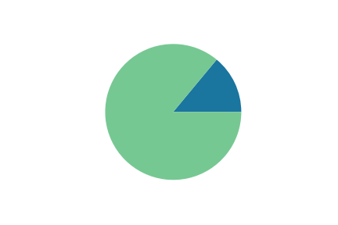
Re-referral Rate
16.26% Re-referrals
115,523 total referrals
18,781 re-referrals

Slide 4
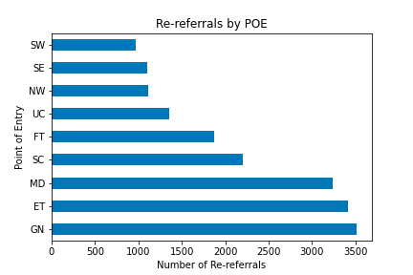
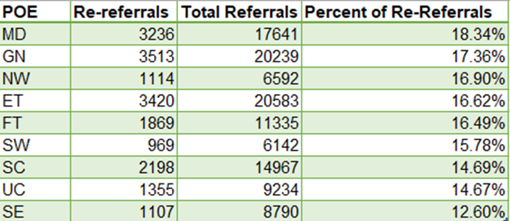
Re-referrals By Point of Entry Office

Slide 5
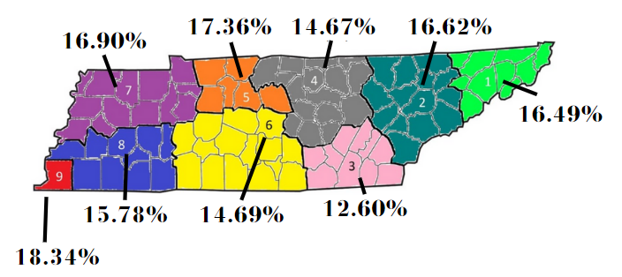
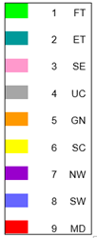
Percent of re-referrals By Point of Entry Office

Slide 6
Key Points
15,641 children with more than 1 referral in Tennessee.
MD, GN, and NW Point of Entry offices have the highest percentage of re-referrals.
Recommendations:
Add a referral id that links to the child id to keep track of family relocation and maintain a consistent record of past referrals.
Allow referral sources a way to see if children already have an existing referral.

Slide 7
Referral Sources with Higher Rates of Successful Referrals
Notes:
Second Question

Slide 8
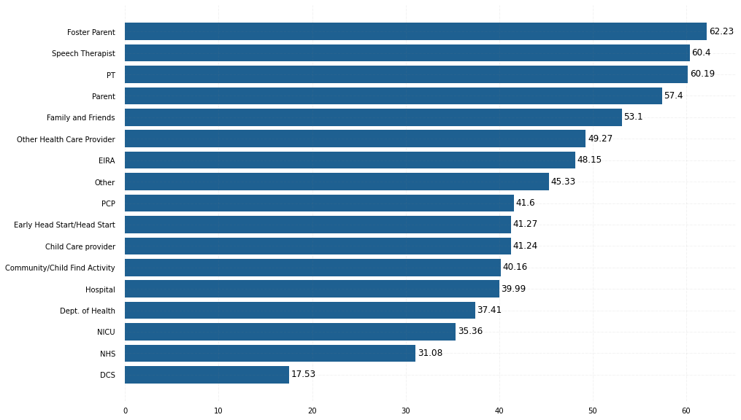
Successful Referral Percentages

Slide 9
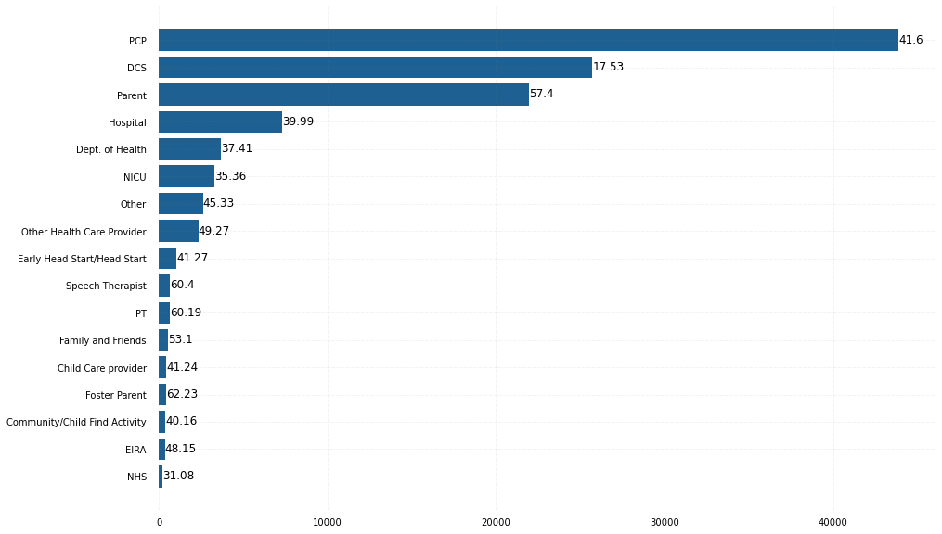
Total Referrals with Success Percentage

Slide 10
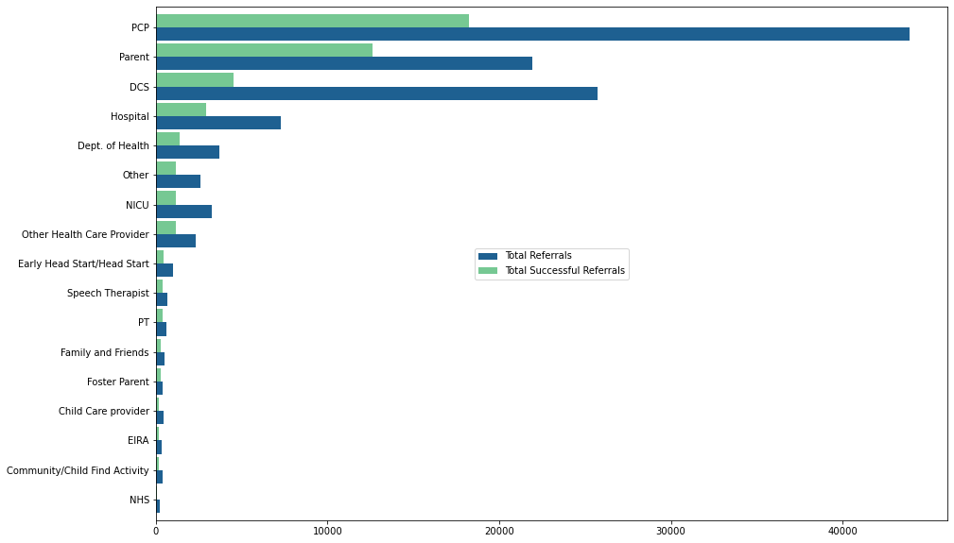
Total Referrals vs Total Successful Referrals

Slide 11
Key Points
Out of 24 referral source types, only 17 have made 100 or more referrals since 2016
5 most successful referral source types: Foster Parent – 62.23%
Speech Therapist – 60.4%
Physical Therapist – 60.19%
Parent – 57.4%
Family & Friends – 53.1%
5 least successful referral source types: DCS – 17.53%
NICU – 35.36%
NHS – 31.08% Dept of Health – 37.41%
Hospital – 39.99%
PCP is the biggest referral source, but ranks 9 out 17 for successful referral percentage at 41.6%
DCS is the second biggest referral source, but ranks 17 out 17 for successful referral percentage at 17.53%
Parent is the third biggest referral source, but ranks 4 out of 17 for successful referral percentage at 57.4%
Resource types who work more closely with a child have better successful referral percentages
Institutions which typically have transient relationships with a child are the least successful referral sources
Volume of referrals does not equal success of referrals, measured by creation of an IFSP

Slide 12
Average Age and Rate of Successful Referrals by POE
Notes:
Third Question

Slide 13
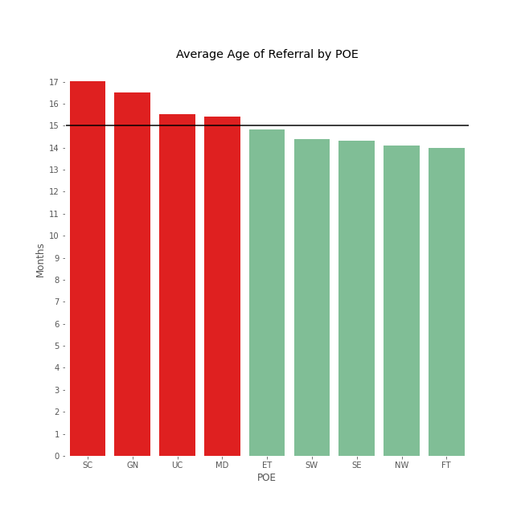
What is a child’s average age at referral? How do POE’s compare?
15 months
*Potential POEs of concern where average age of referral is greater than 15 months are:
South Central (17.01 months)
Greater Nashville (16.49 months)
Upper Cumberland (15.54 months)
Memphis Delta (15.40 months)
*Notification date used for calculation
Notes:
Calculated using the notification date to understand the average age of a child when referred
Calculated the number of days from DOB to notification date and converted to age in months
The black line represents the target of 15 months (maximum age of concern)
4 potential POEs of concern (listed on slide)

Slide 14
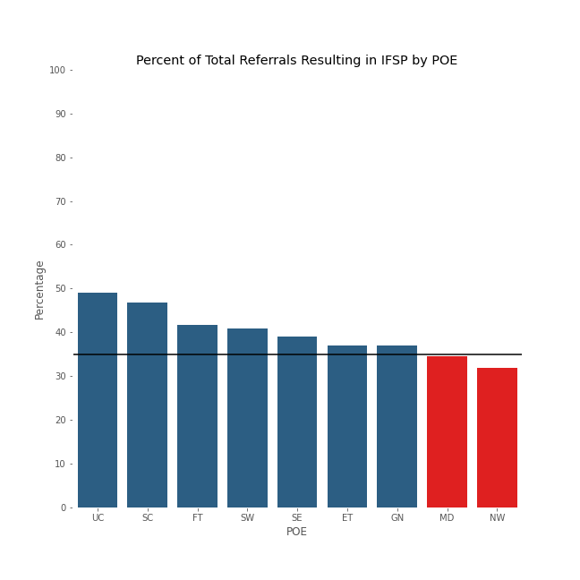
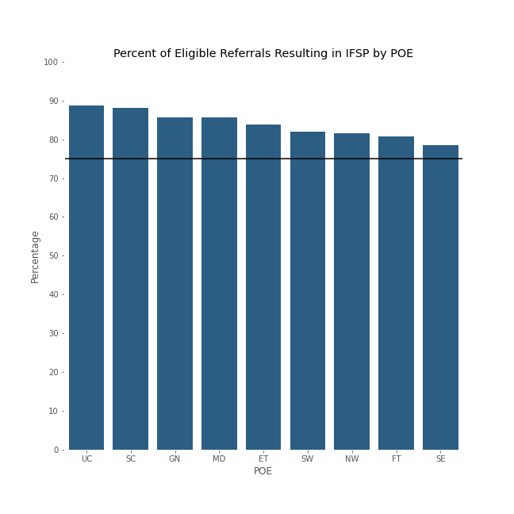
Total Referral vs Eligible Referral IFSP Result How do POE’s compare?
75%
35%
*Only POE’s of potential concern are
Memphis Delta (34.45%) and Northwest (31.87%)
Notes:
Fig 1 (on the left)
Represents the percentage of total referrals that resulted in an IFSP broken down by POE
The black line represents the target percentage of 35%
2 POEs of potential concern (listed on the slide) fell below 35%
Fig 2 (on the right)
Represents the percentage of all eligible referrals that resulted in an IFSP broken down by POE
The black line represents the target percentage of 75%
NO POE’s of concern for this metric
Takeaway –
Memphis Delta has a higher age of referral and a lower percent of total referrals resulting in an IFSP
Eligible children have a higher percentage of resulting in an IFSP.
Parental consent/understanding is a critical component in reaching eligibility (extra data of this is available upon request please refer to Michael Norman)
Did not attempt to establish a correlation between the average age of referral and successful referrals, further research is recommended

Slide 15
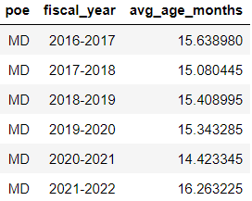
Average Age of Referral for Memphis Delta by Year

Slide 16
Key Points
is a potential POE of concern with a higher average age of referral and a lower percent of total referrals resulting in an IFSP.
Eligible children have a higher percentage of resulting in an IFSP.
Memphis DeltaParental consent/understanding is a critical component in reaching eligibility (extra data of this is available upon request please refer to Michael Norman).
Did not attempt to establish a correlation between the average age of referral and successful referrals, further research is recommended.

Slide 17
Age, Referral Source &
Socioeconomic Status (County & POE SES)
Notes:
Fourth question

Slide 18
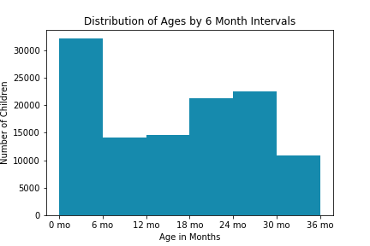
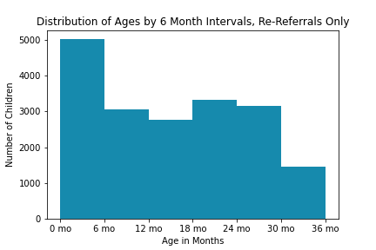
Referrals by Age
The highest proportion of referrals is for children ages 0-6 months
The patterns of referrals and re-referrals by age are very similar, which suggests there is generally not a long delay in re-referrals

Slide 19
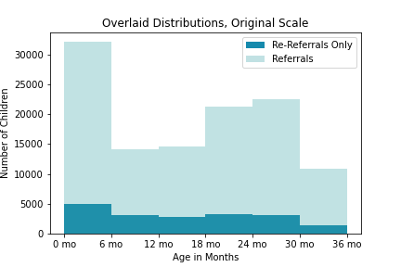
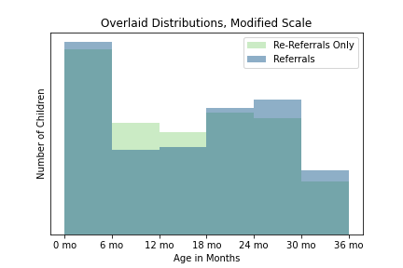
Referrals vs. Re-referrals
The only developmental period with a higher proportion of re-referrals is 6-18 months

Slide 20
Referral and Re-Referrals by Source
The top 5 sources for referrals and re-referrals are identical, and percentages are very similar
 | Referral | Re-referral
PCP | 37.99% | 35.48%
DCS | 22.26% | 22.42%
Parent | 18.99% | 20.13%
Hospital | 6.31% | 6.22%
Dept. of Health | 3.18% | 3.57%

Slide 21
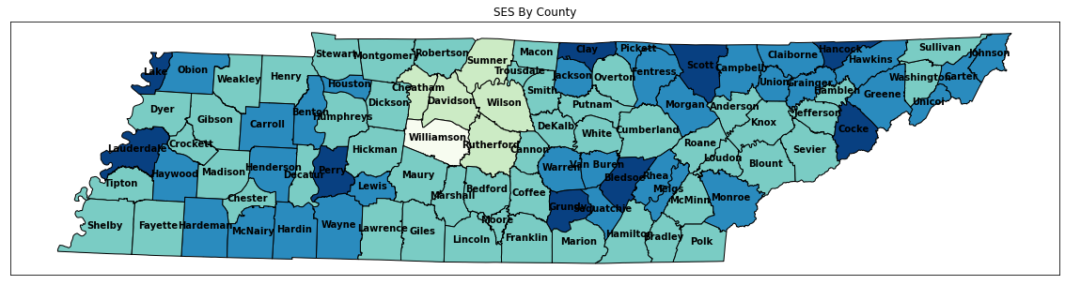
Socioeconomic Status (County)
This map of Tennessee displays the SES status by county
The lighter the color, the higher the SES
The darker the color, the lower the SES

Slide 22
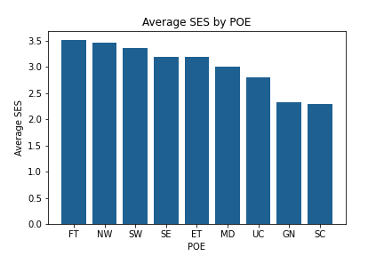
Socioeconomic Status (POE)
POE | SES
FT: First Tennessee | 3.51
NW: Northwest | 3.46
SW: Southwest | 3.36
ET: East Tennessee | 3.19
SE: Southeast | 3.19
MD: Memphis Delta | 3.00
UC: Upper Cumberland | 2.81
GN: Greater Nashville | 2.32
SC: South Central | 2.29
We took the SES information we had for counties and calculated the average SES for all 9 POEs
Distressed: 5 At-Risk: 4 Transitional: 3 Competitive: 2 Attainment: 1
Using these charts, we are able to easily identify the POE territories with the highest levels of economic need.

Slide 23
Key Points
The highest proportion of referrals is for children ages 0-6 months
The patterns of referrals and re-referrals by age are very similar, which suggests there is generally not a long delay in re-referrals
The only developmental period with a higher proportion of re-referrals is 6-18 months
POE locations with the highest levels of economic need:
First Tennessee, Northwest, Southwest
POE locations with the lowest levels of economic need:
Upper Cumberland, Greater Nashville, South Central

Slide 24
Early Exit Rates for Point of Entry Offices and Service Coordinators
Notes:
Last question

Slide 25
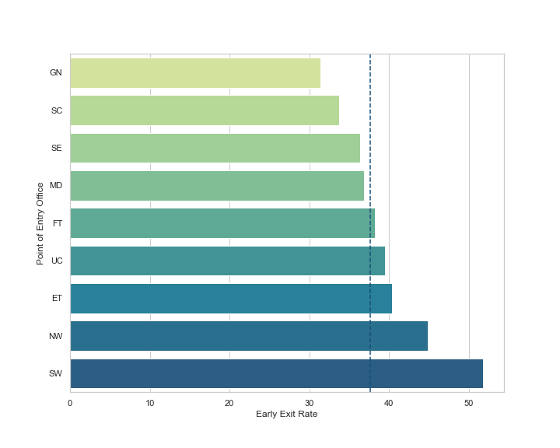
Early Exit by Point of Entry Office
Average TEIS Early Exit Rate = 37.65%
Point of Entry Office | POE Early Exit Rate | Total Service Coord. | Service Coord. with above average rate | Proportion of Service Coord. with above average rate
Southwest | 51.80% | 19 | 6 | 32%
Northwest | 44.86% | 12 | 4 | 33%
East Tennessee | 40.65% | 49 | 26 | 53%
Upper Cumberland | 39.44% | 16 | 8 | 50%
First Tennessee | 38.25% | 30 | 14 | 47%
Memphis Delta | 36.83% | 53 | 31 | 58%
Southeast | 36.33% | 24 | 15 | 63%
South Central | 33.75% | 40 | 21 | 53%
Greater Nashville | 31.39% | 50 | 29 | 58%

Slide 26
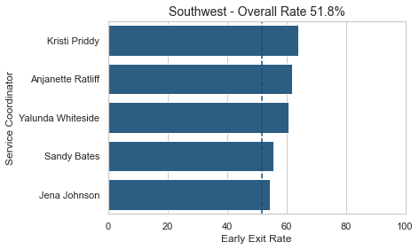
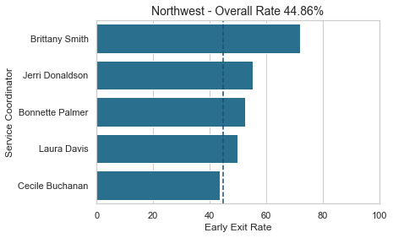
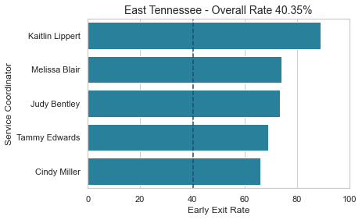
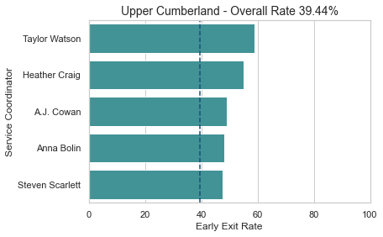
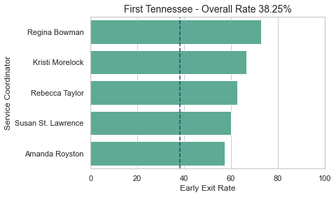
Early Exit Rate by Service Coordinator
214 / 335
18 / 25
13 / 21
112 / 203
165 / 272
128 / 244
135 / 243
75 / 150
6 / 11
107 / 245
8 / 9
43 / 73
8 / 11
17 / 23
134 / 244
52 / 78
11 / 15
29 / 59
54 / 86
29 / 42
121 / 251
6 / 10
93 / 141
132 / 277
35 / 61

Slide 27
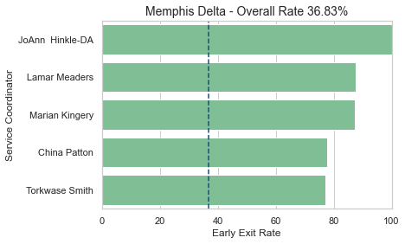
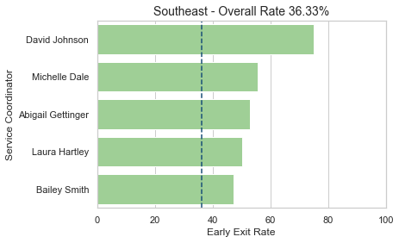
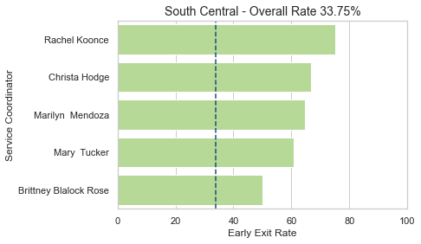
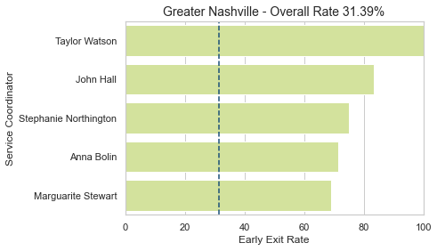
Early Exit Rate by Service Coordinator
11 / 11
27 / 36
7 / 8
5 / 9
48 / 55
9 / 17
14 / 18
64 / 127
17 / 22
46 / 97
9 / 12
4 / 4
6 / 9
5 / 6
20 / 31
3 / 4
14 / 23
5 / 7
42 / 84
9 / 13

Slide 28
Key Points
The average TEIS Early Exit rate is 37.65%
5 Point of Entry Offices have Early Exit rates above the overall average:
Southwest
Northwest
East Tennessee
Upper Cumberland
First Tennessee
154 Service Coordinators have rates above the average for their Point of Entry Office (full list is available)
We suggest East Tennessee POE as an area to focus on
High overall Early Exit rate
High proportion of Service Coordinators whose rates fall above that average

Slide 29
Key Takeaways
Add a referral id that links to the child id to keep track of family relocation and maintain a consistent record of past referrals.
Allow referral sources a way to see if children already have an existing referral.
Resource types who work more closely with a child have better successful referral percentages
Institutions which typically have transient relationships with a child are the least successful referral sources
Volume of referrals does not equal success of referrals, measured by creation of an IFSP
Memphis Delta is an area of concern with a higher average age of referral and a lower percent of total referrals resulting in an IFSP
Parental consent/understanding is a critical component in reaching eligibility
Concentrate more resources on lower levels of social economic areas in TN for better rates of referrals
Focus on East Tennessee area for high overall early exit rate and high proportion of Service Coordinators whose rates fall above average
Notes:
Summary/ Recommendations

Slide 30
Questions?
Thank you for the opportunity to analyze this data. We truly appreciate this experience.

